Slide 1
Announcements
Fri. Jan 8^{th-} Texas A&M Corpus Christi Virtual Informational Meeting at 10 AM
Zoom link: https://bisdtx-org.zoom.us/j/2443705969
Weds. January 13th ACC Junior Jumpstart. Mandatory for all 11th graders 1:30-4:30 PM
Mon. Jan 18^{th-} MLK Day Student and Staff Holiday
Tues. Jan. 19^{th-} ACC starts back
*Remember on ACC days (even before ACC starts), you must still check in with Mr. Gordon for CRCA attendance purposes.
Tues. Jan. 26th Preliminary SAT (PSAT) for Juniors. Be at the school by 8:40 AM, you will be done by noon.
If you took your school pictures on Dec. 11th, your packet can be picked up from Mr. Gordon in the library.

Slide 2
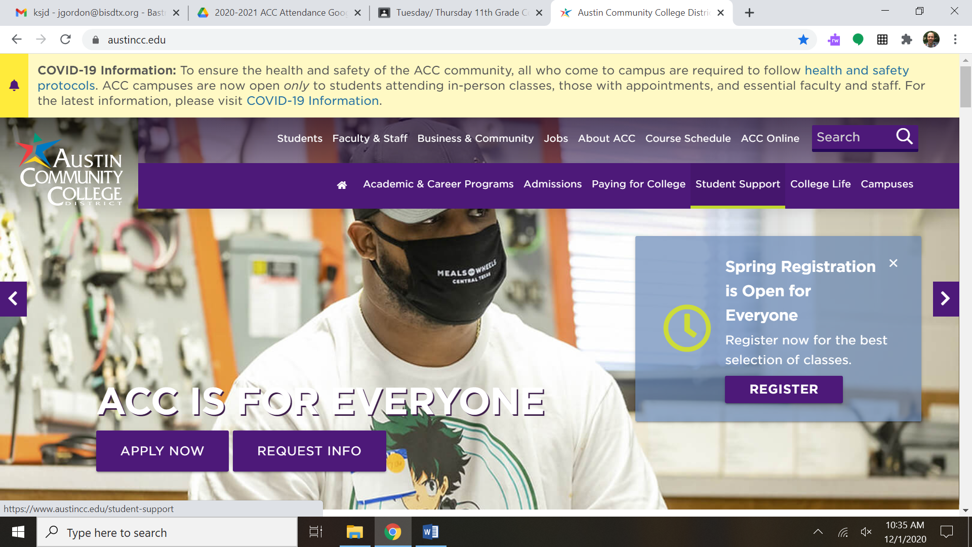
How to Check ACC Spring Semester Classes
Step 1: Go to austincc.edu and click “Students” in the top left corner

Slide 3
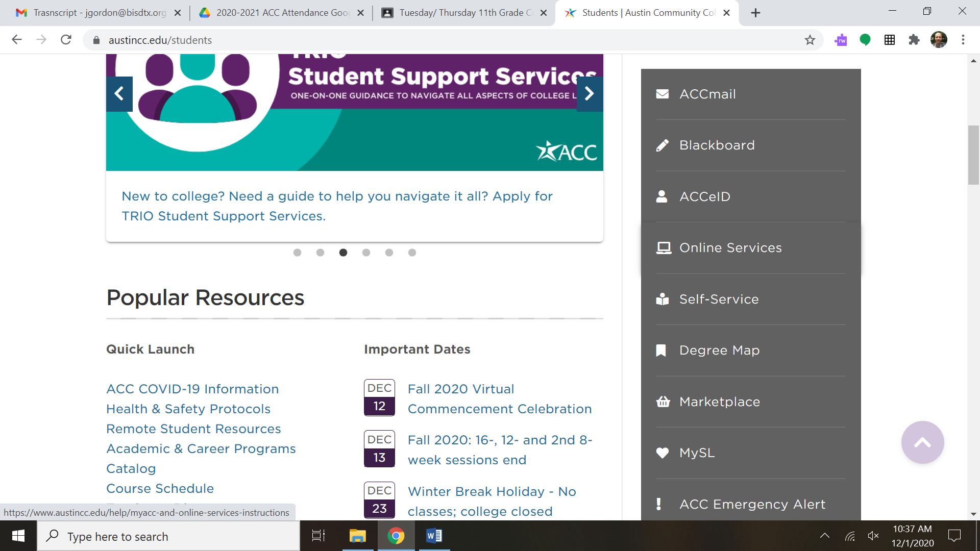
How to Check ACC Spring Semester Classes
Step 2: Scroll down and click “Self-Service” in the middle right.

Slide 4
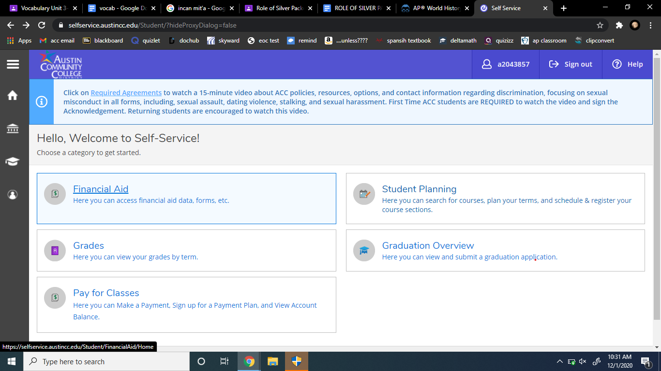
How to Check ACC Spring Semester Classes
Step 3: Login to My ACC and click on “Student Planning”

Slide 5
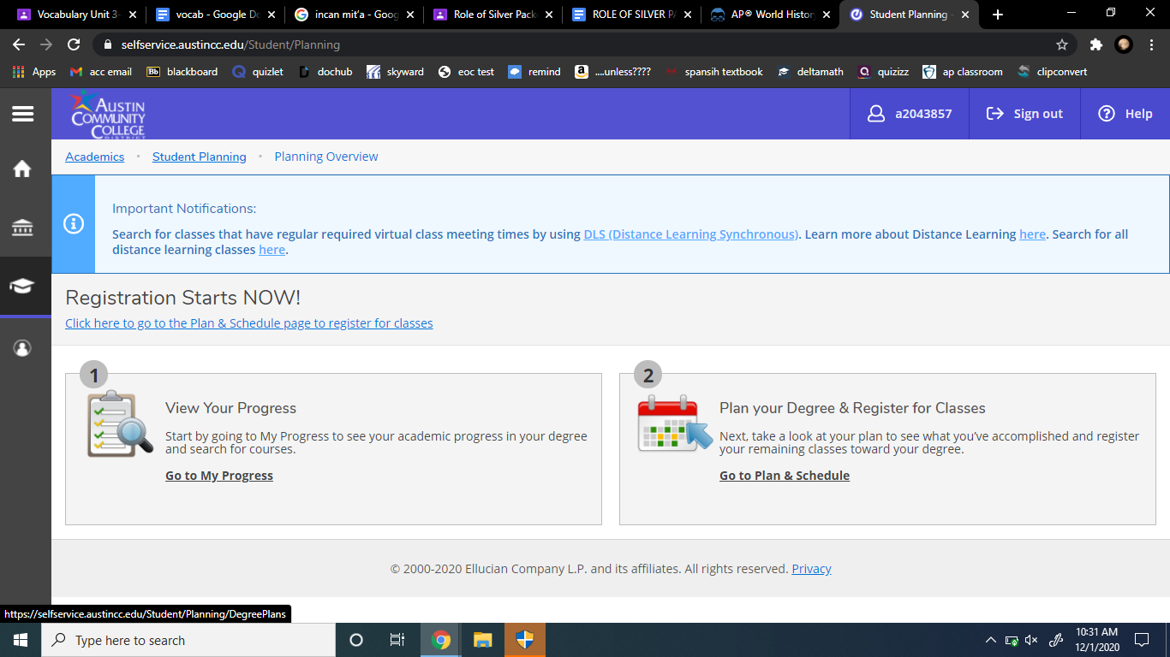
How to Check ACC Spring Semester Classes
Step 4: Click on “Go to Plan & Schedule” under Plan your Degree & Register for Classes

Slide 6
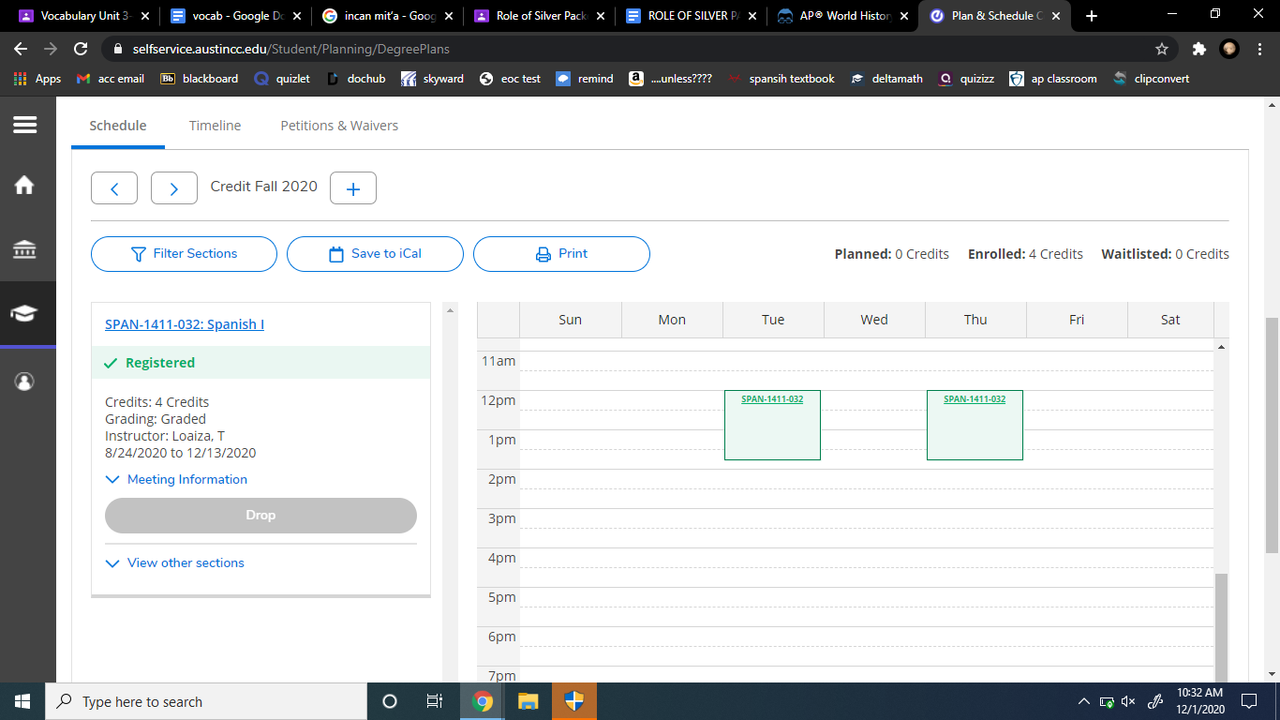

How to Check ACC Spring Semester Classes
Step 5: Scroll down and you will see the schedule. Be sure it says “Credit Spring 2021”. If not, use the arrows.

Slide 7
How to Check ACC Spring Semester Classes
If something is incorrect, please email Mr. Longoria and Mr. Gordon ASAP.
Freshmen should be enrolled in EDUC 1300, Sophomores should have 2 classes, Juniors should have 3, and Seniors should have 4 (unless otherwise discussed with Mr. Longoria).

